Slide 1

MALLA REDDY COLLEGE OF ENGINEERING & TECHNOLOGY (Autonomous Institution – UGC, Govt. of India) DEPARTMENT OF COMPUTER SCIENCE AND ENGINEERING
5G NETWORK SIMULATION USING NS3
Under the Guidance of
Name: Dr.G.L.N.JAYAPRADA
Designation: Associate Professor
Batch No: 21
Names with roll numbers:
K SAI BHUVANESHWARI 20N31A6629
M PAWAN KALYAN 20N31A6632
G BHARADWAJ 21N35A6601

Slide 2
AGENDA
Introduction
Abstract
Existing system
Proposed system
Software and Hardware Requirements
Literature survey
System architecture(Modules Explanation)
UML Diagrams
Algorithms and technologies
Output screens/ Results
Conclusion
Future scope

Slide 3
INTRODUCTION
Welcome to our presentation on 5G technology, a game-changer in wireless communication. In this presentation, we'll explore the foundational principles of 5G, its visionary capabilities, and why it's essential for our increasingly connected world.
We'll start by understanding the basics of wireless communication, including transmission mediums, modulation techniques, and factors influencing data rates. Then, we'll delve into cellular communication concepts, such as cell layout and handover mechanisms, paving the way to comprehend 5G networks.
In this project, we are aiming to reduce the overhead and latency significantly 5G networks by following a strategy that integrates security functionalities directly into header compression. This approach streamlines data transmission processes, enhancing efficiency while bolstering network security.

Slide 4
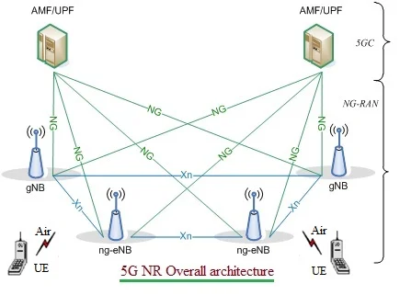

Slide 5
ABSTRACT
In recent months, free deep learning-based software tools has facilitated the creation of credible face exchanges in videos that leave few traces of manipulation, in what they are known as "DeepFake"(DF) videos.
This project utilizes the ns-3 network simulator to analyze and simulate 5G network behavior. It covers network topology setup, application configuration, tracing mechanisms, and TCP congestion control analysis.
Beginning with an overview of ns-3, it explores various network setups, including point-to-point links, CSMA LANs, and wireless networks. It emphasizes tracing mechanisms like Wireshark, ASCII, and PCAP, crucial for capturing events and data changes.
Additionally, it implements header compression in the PDCP layer to optimize bandwidth and enhance network efficiency in 5G contexts, providing valuable insights into network performance.

Slide 6
EXISTING SYSTEM
The existing system architecture of 5G networks relies on the Packet Data Convergence Protocol (PDCP) layer to facilitate efficient data transmission.
However, its separation of security functions, such as integrity protection and ciphering, from header compression leads to increased overhead, latency, and resource consumption within the network.
This disjointed approach requires data packets to undergo multiple processing stages, resulting in inefficiencies and potential performance bottlenecks.

Slide 7
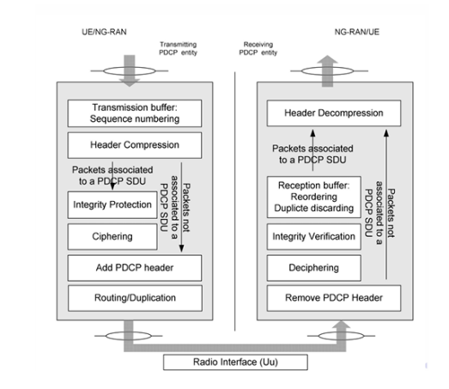

Slide 8
PROPOSED SYSTEM
In our proposed system, we aim to enhance the efficiency of packet flow in 5G networks by optimizing the communication process between gNodeB and User Equipment (UE).
This involves bypassing certain protocol layers, including Ciphering, Deciphering, Integrity Protection, and Integrity Verification, to establish a direct connection between Header Compression and the Packet Data Convergence Protocol (PDCP) layers.
By removing these layers, which primarily focus on security and encryption, we can potentially reduce processing overhead and improve throughput.
Our approach leverages the capabilities of the Network Simulator 3 (NS3), an open-source discrete-event network simulator.

Slide 9
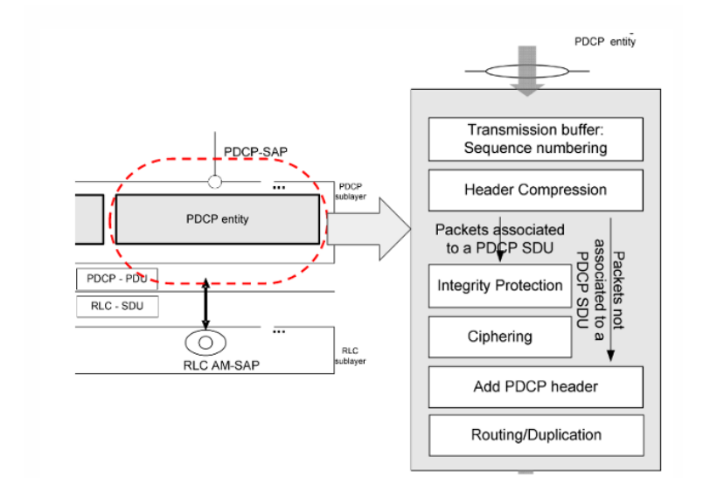

Slide 10
NS3 allows us to model complex network scenarios, customize protocol stacks, and analyze network performance.
By simulating this streamlined packet flow, we anticipate benefits such as reduced latency, improved resource utilization, enhanced network performance, and lower energy..

Slide 11
SOFTWARE AND HARDWARE REQUIREMENTS
SOFTWARE REQUIREMENTS
• Operating System: Ubuntu • NetAnim: To simulate the packet flow in the network. • Packages: ns3-tools, CMake. • Languages: C/C++ • IDE: Visual Studio • Wireshark

Slide 12
HARDWARE REQUIREMENTS
Ram: 4GB or more
Processor: Intel Core i5 or More
Hard disk space: 250GB or more

Slide 13
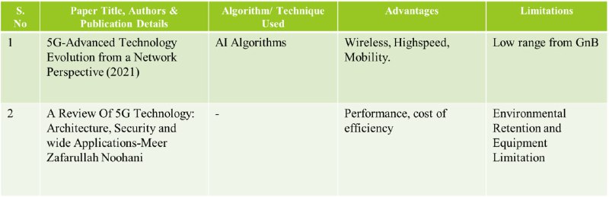
Literature Survey

Slide 14
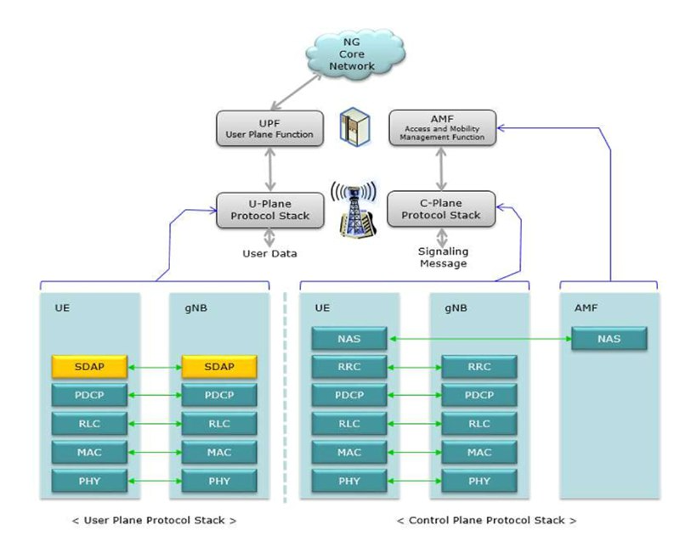
SYSTEM ARCHITECTURE

Slide 15
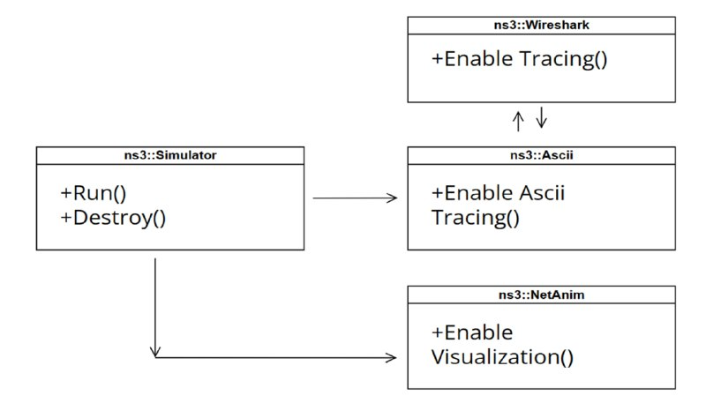
UML DIAGRAMS
1.Use Case Diagram

Slide 16
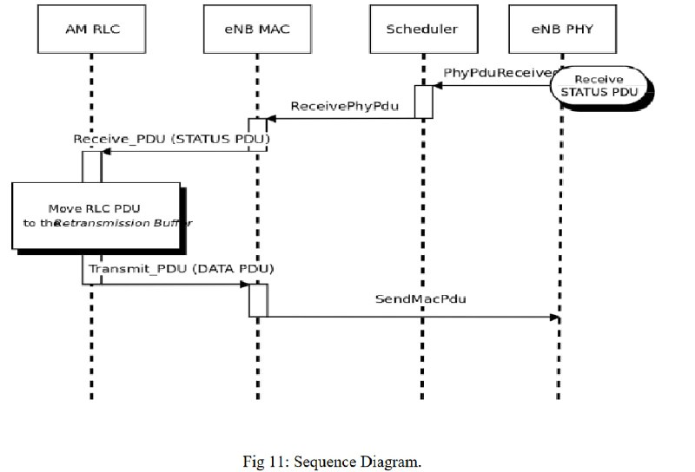
2.Sequence Diagram

Slide 17
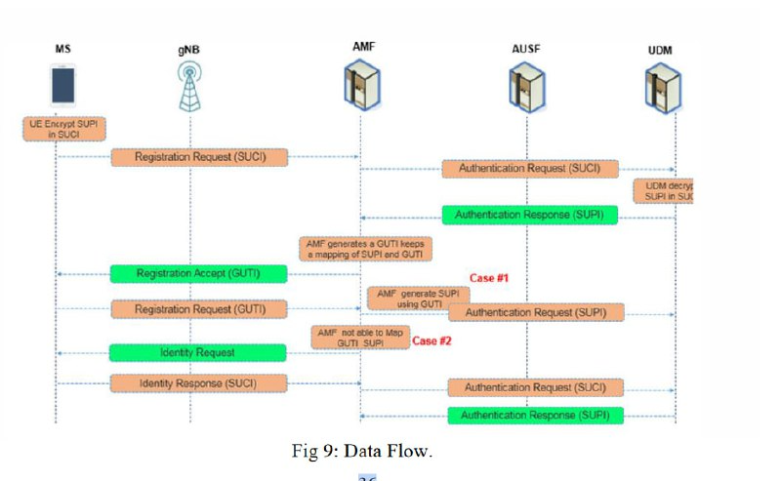
3. DataFlow Diagram

Slide 18
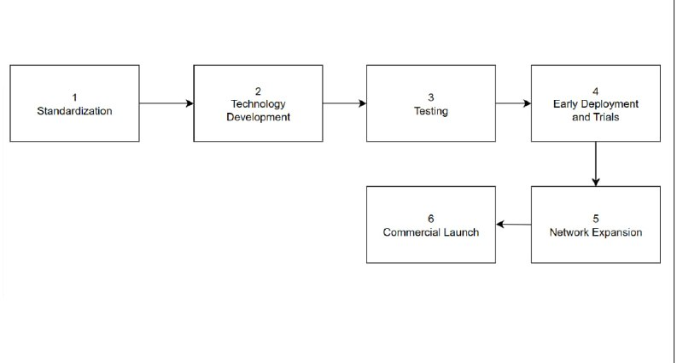
4.Deployment Diagram

Slide 19
Algorithms and Technologies
NS3(Network Simulator 3): NS3 serves as the cornerstone technology for our project. It is an open-source discrete-event network simulator renowned for its ability to model intricate network scenarios. With NS3, we can customize protocol stacks, simulate packet flow optimizations, and evaluate network performance metrics. Its flexibility and extensive features make it an ideal choice for analyzing and optimizing telecommunications networks like 5G.
NFV (Network Function Virtualization): NFV plays a crucial role in our project by virtualizing network functions traditionally implemented in hardware. By decoupling network functions from proprietary hardware appliances, NFV enables greater flexibility, scalability, and cost-effectiveness. In our context, NFV facilitates the virtualization of certain network functions, allowing for easier deployment and management within our simulated 5G environment.

Slide 20
SDN (Software-Defined Networking): SDN complements our project by providing a programmable approach to network management. With SDN, network control is centralized and abstracted from the underlying infrastructure, allowing for dynamic configuration and optimization. In our scenario, SDN enables efficient routing and traffic management, enhancing the overall performance and scalability of our simulated 5G network within NS3.

Slide 21
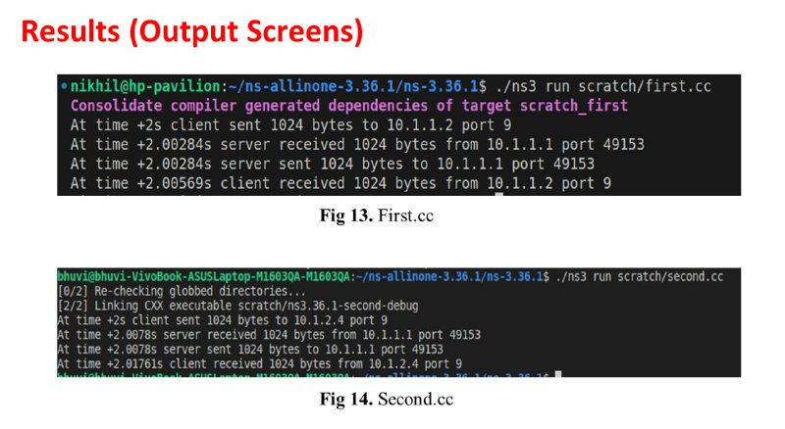
OUTPUT SCREENS

Slide 22
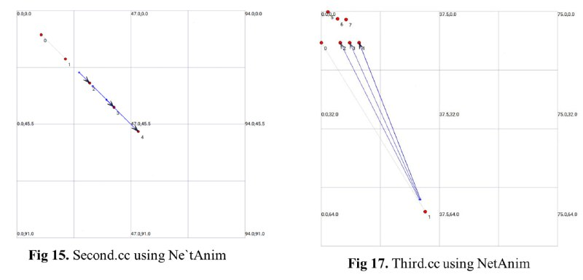

Slide 23
CONCLUSION
In conclusion, our project represents a significant stride forward in the realm of 5G network simulation and analysis. By equipping the ns-3 simulator with advanced functionalities tailored for 5G research, we have empowered researchers and network engineers worldwide to explore, innovate, and shape the future of wireless communication systems. As we conclude this chapter, we remain steadfast in our commitment to advancing the frontiers of 5G technology and fostering a future where seamless connectivity enriches lives across the globe.

Slide 24
FUTURE SCOPE
Firstly, refining algorithms and techniques to optimize the integration of security functionalities with header compression could further reduce overhead and latency, enhancing overall networ efficiency.
Secondly, exploring methods to scale the system to accommodate increasing data traffic and connected devices in 5G networks is essential. Additionally, enhancing security measures against emerging cyber threats is crucial for sustained network resilience.

Slide 25
REFERENCES
https://ieeexplore.ieee.org/abstract/document/9926175?casa_token=UH6iYO0qfrsAAAAA:W1TNAnVuhiDW7obXZQU65X_6b17T_7ejI7moWHPCFGVo9FZm7pYXQNjs3cP8uD1dIhnToUjQv8CzSg
https://www.sciencedirect.com/science/article/pii/S187705092200477X [5G NR Configured Grant in ns-3 Network Simulator for Ultra-Reliable Low Latency Communications]
https://www.researchgate.net/publication/279459069_5G_mmWave_Module_for_ns-3_Network_Simulator
https://ieeexplore.ieee.org/abstract/document/5734730?casa_token=CiTV_dX6iJcAAAAA:5Y4wewmFzfuUlSZQMe4G6Gfa5uldleV8n4PEqXPDFFDX7jykgbCJShwSjIf0GB0nK3blh04ykNP5fA [ importance of the simulation against encryption]
https://ieeexplore.ieee.org/abstract/document/10457056?casa_token=QafFjSdFgroAAAAA:iCEQ19GT5YzbezfQ00s43bEVnKSIA0uRkSBGq_UmS1yjYvQ0QBMRPt2aKzf6_a6V9DB7KH9xjWsC7w [SPECTRAL TEMPORAL GRAPH NN FOR CSI PREDICITION]

Slide 26
THANKYOU

